Slide 1

Strategic Planning & Operations
Building Services
Child Nutrition
Fiscal Services
Transportation

Slide 2

summer 2013

Slide 3
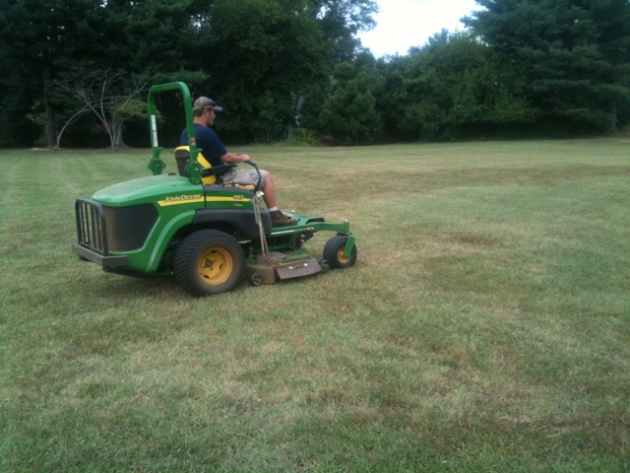
BUILDINGS & GROUNDS
Over 40 employees of the Buildings & Grounds Department worked throughout the summer on various tasks including:
  Mowing/grounds
  Moving furniture
  Assisting contractors
  Carpentry work
  Electrical work
  Mechanical work
  Plumbing work

Slide 4
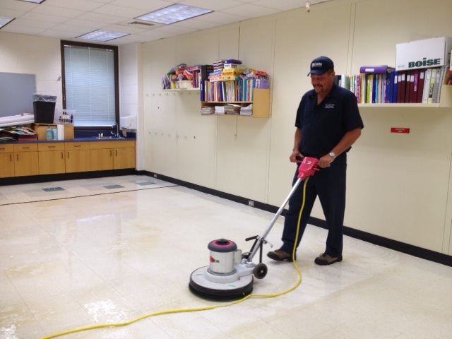
CUSTODIAL WORK
Over 140 employees of the Custodial Department worked throughout the summer on various tasks including:
Detailed cleaning of ALL schools, ceiling to floor.
Floor refinishing
Provide services for numerous summer school programs, CAI, YMCA, CFA, Parks & Rec., sports camps, and community building rentals.

Slide 5
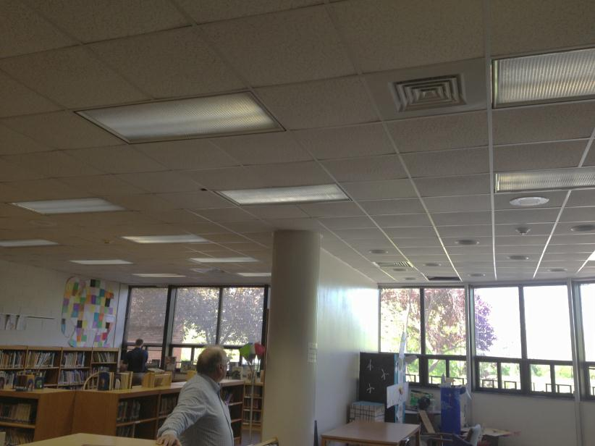
Environmental management
Throughout the summer there were several ongoing initiatives to reduce water & energy consumption underway including:
Energy Star site verifications for eligible schools
Low-flow sink aerator installations
Irrigation control planning
Lighting upgrades

Slide 6
Capital project overview
Building Services is managing over $3 mil worth of capital projects:
$500,000 +
  Yancey Elementary HVAC &
  Lighting Replacement
  Murray High School Renovation
HVAC Replacement/Installation
  Jouett Chiller
  Jouett Kitchen AC
  Stone Robinson
  Western Albemarle
Roof Replacement
  Albemarle
  Cale
  Building Services
$100,000 - $200,000
  Jouett Tennis Court Reconstruction
  VMF Lift Replacement
  Flooring Replacement & Asbestos Removal
  Playground Equipment Replacement
Less than $50,000
  Jouett Brick Repointing
  Scottsville Structural Repair
  Woodbrook Exterior Door Replacement
  Locker Refurbishment
  Generator Replacements

Slide 7
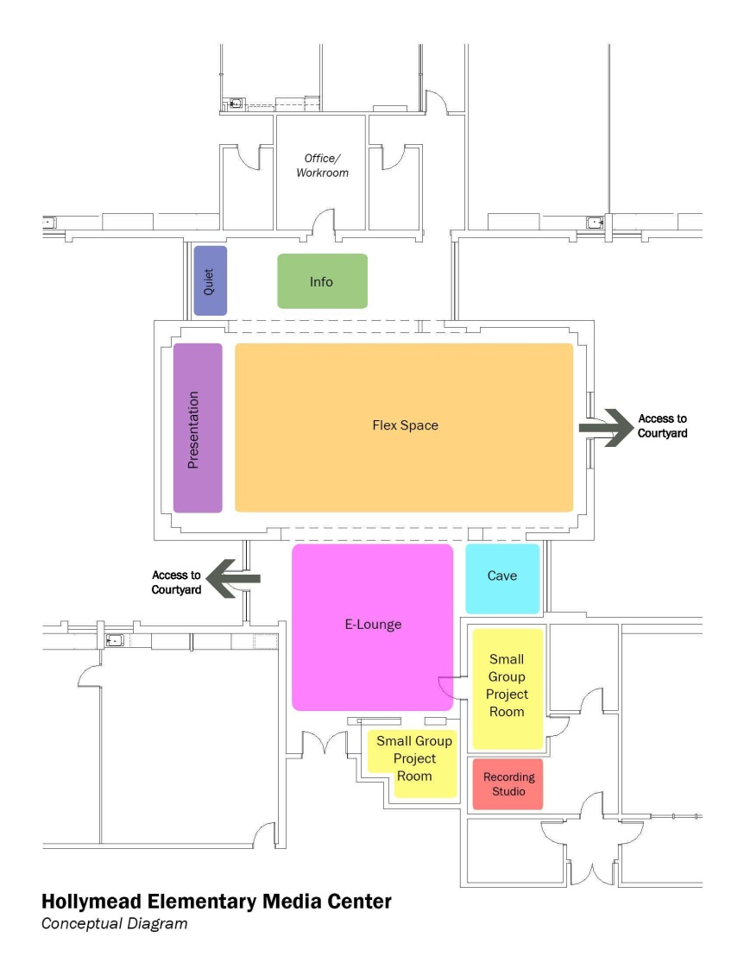
Design 2015
In support of the Design 2015 Grant program, six schools received renovations to support contemporary learning:
Albemarle: Writer’s Lounge
Woodbrook: Art Room
Hollymead: Art Room & Media Center
Meriwether Lewis :Media Center
Murray Elementary: Cafeteria & Maker Space
Henley: 21st Century Classrooms

Slide 8
Child Nutrition
summer 2013

Slide 9
SUMMER CHECKLIST
Standard summer work revolves around closing out a school year, serving summer feeding and caterings, and preparation for the new school year.
Training will be provided on August 13th & 14th. ServSafe Food Safety and Sanitation training and test for certification for cafeteria managers. Back-to-school meeting for all CNP staff on August 20th to include update on regulations, school board strategic plan- Horizon 2020, customer service, health department review, fire extinguisher use.
Staffing- hired 1 assistant food service manager, and 10 food service associates
Menu planning, food bids, updating nutritional information/allergens, food production records, updating School Nutrition agreements with USDA.

Slide 10
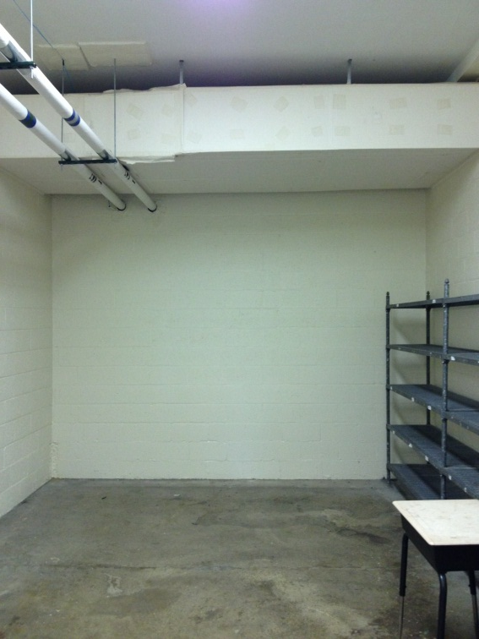
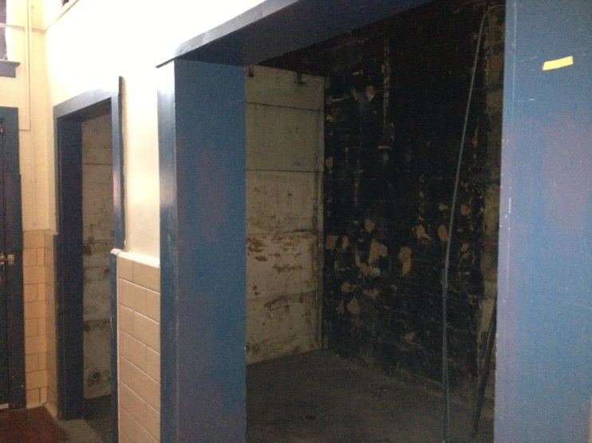
Equipment
Jack Jouett Middle School and B.F. Yancey Elementary School – addition of A/C, and replaced ovens.
Crozet Elementary -Replaced Steamer.
Burley Kitchen Renovation – security gate,
walk in cooler/freezer, dry storage room.

Slide 11
Fiscal Services
summer 2013

Slide 12
Miscellaneous projects
Closing of FY 2012/2013 Fiscal Year
Opening of FY 2013/2014 Fiscal Year
Conversion of Budget Process to New Coding Structure
Training Office Associate staff in new Building Rental software/process
Preparing and Training staff for purchasing cards

Slide 13
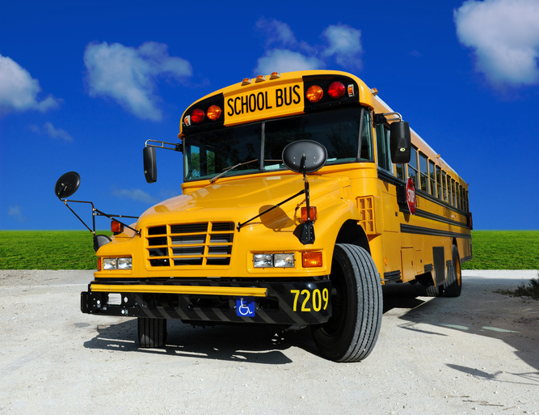
Transportation
summer 2013

Slide 14
Summer Work Completed
  Supplied 40 buses for Summer School
  Fully Staffed – completed training of new drivers for the first day of school
  Mandt Training – completed for SPED driving staff
  Alternate Fuel - study completed, some fine-tuning ongoing

Slide 15
Summer Work Completed
Route Design – completed preliminary route design with July 19 Power School data
Bus PM – completed annual “deep” preventative maintenance on 98% of fleet

Slide 16
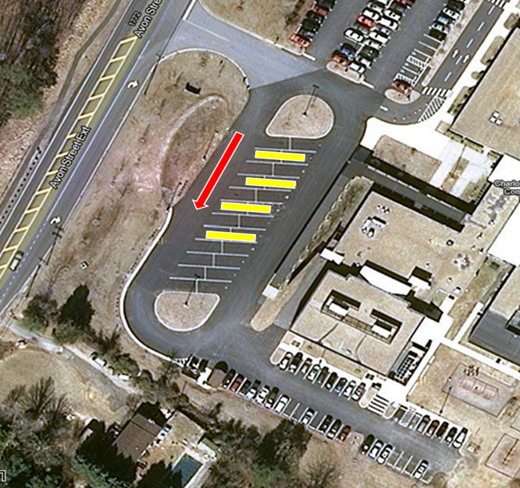
Summer Work Comleted
Bus Loop Safety Plans – completed for each school

Slide 17
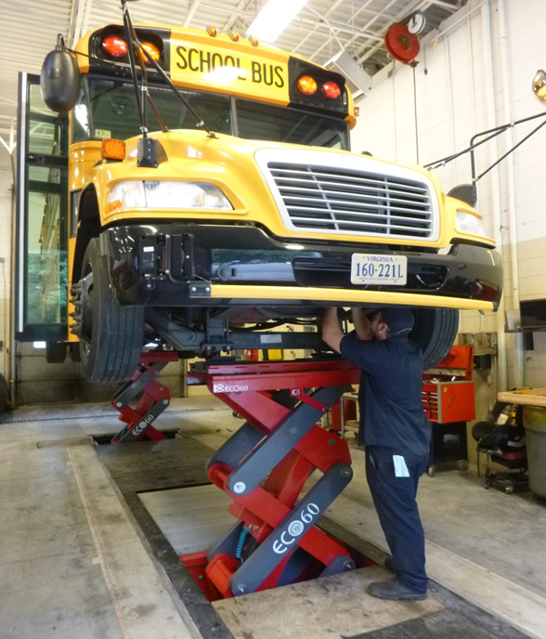
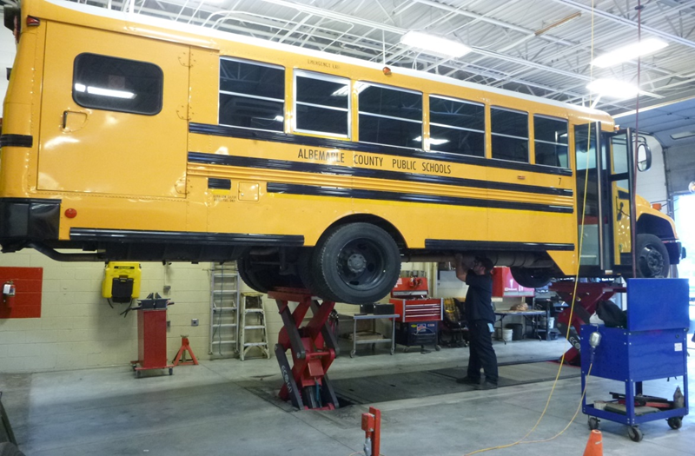
Summer Work Completed
Lift – Building Services installed second of four lifts (one per year)

Slide 18
Work in Progress
Post Cards – will be mailed to parents starting Aug 12 indicating bus stop details
Principal Meetings – Director/Designee is meeting one-on-one with Principals to review results and plan for next year

